Slide 1
List of contents
Nacelle cover design updates
Material choice
Cooling system arrangement
Next week
Federico De Mita

Slide 2
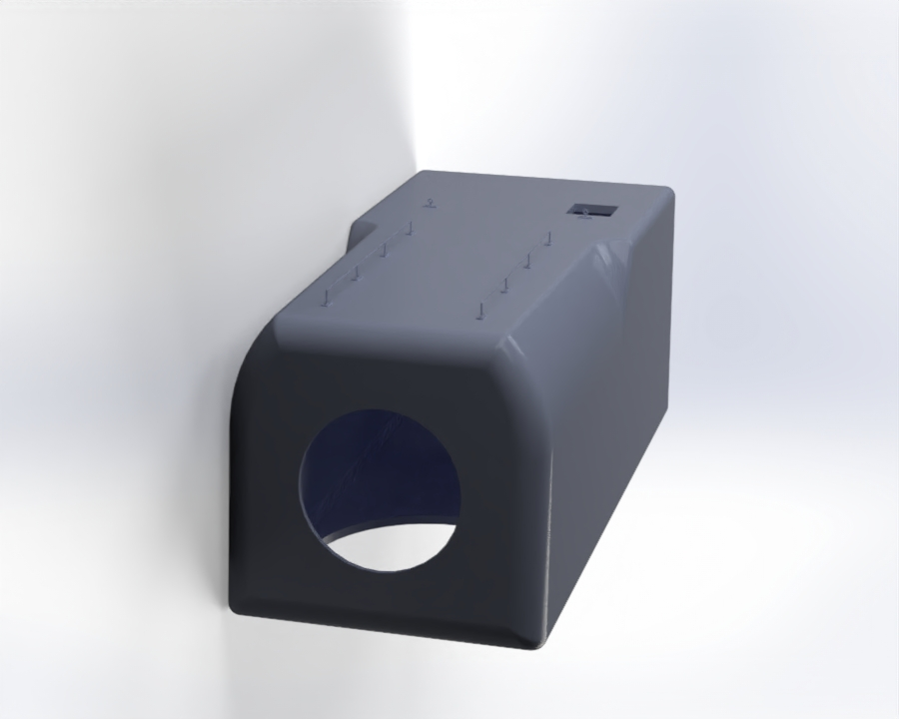
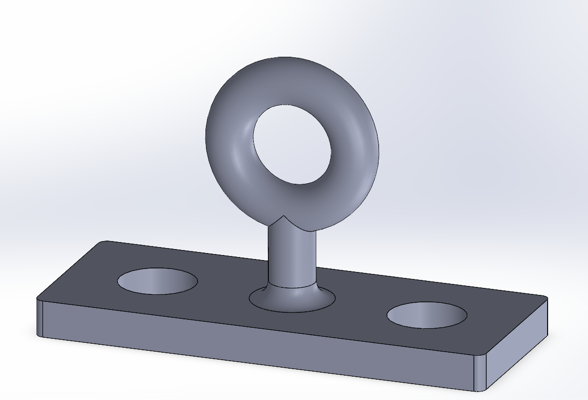
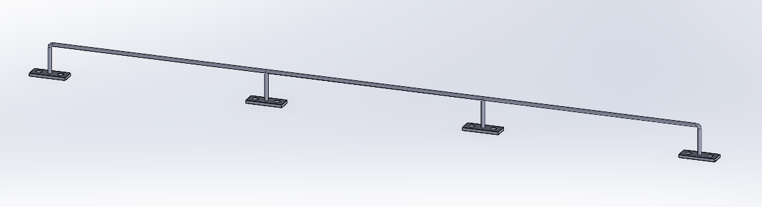
1. Nacelle cover design updates
Additions to the design:
More aerodynamic design
Fixed points for personnel safety
Doorhole for entering the nacelle
Both need detailed designing!
[1]
Federico De Mita

Slide 3
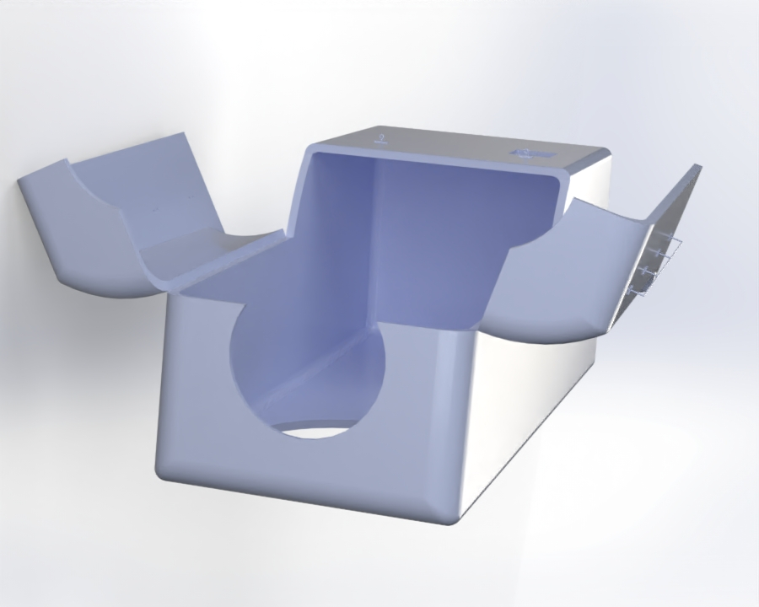
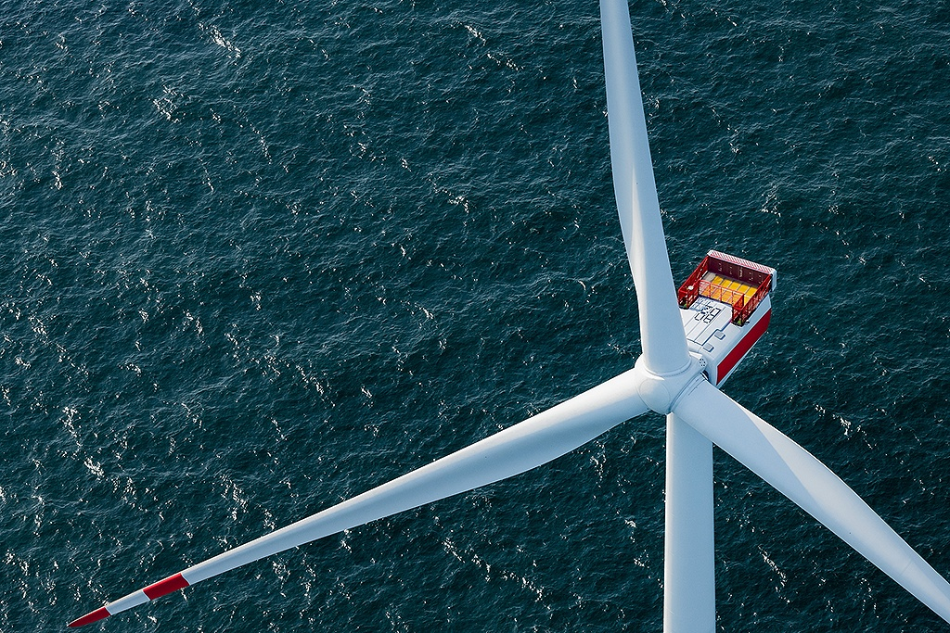
1. Nacelle cover design updates
Openable lid for equipment change
Design inspired by:
Missing joint:
Work in progress
Missing Flanged connection for closure of the lid:
Work in progress
V236-15MW
[1],[2]
Federico De Mita

Slide 4
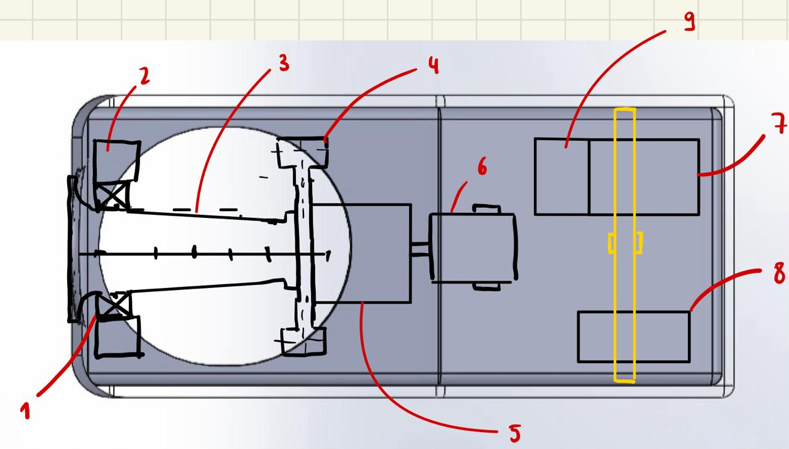
1. Nacelle cover design updates
Initial components arrangement inside of the nacelle
Main bearing
Bearing housing
Shaft
Gearbox housing + elastomeric bearings
Gearbox
Generator
Power converter
Transformer
Control unit box
3.2 m
3.2 m
2.1 m
[1]
Federico De Mita

Slide 5
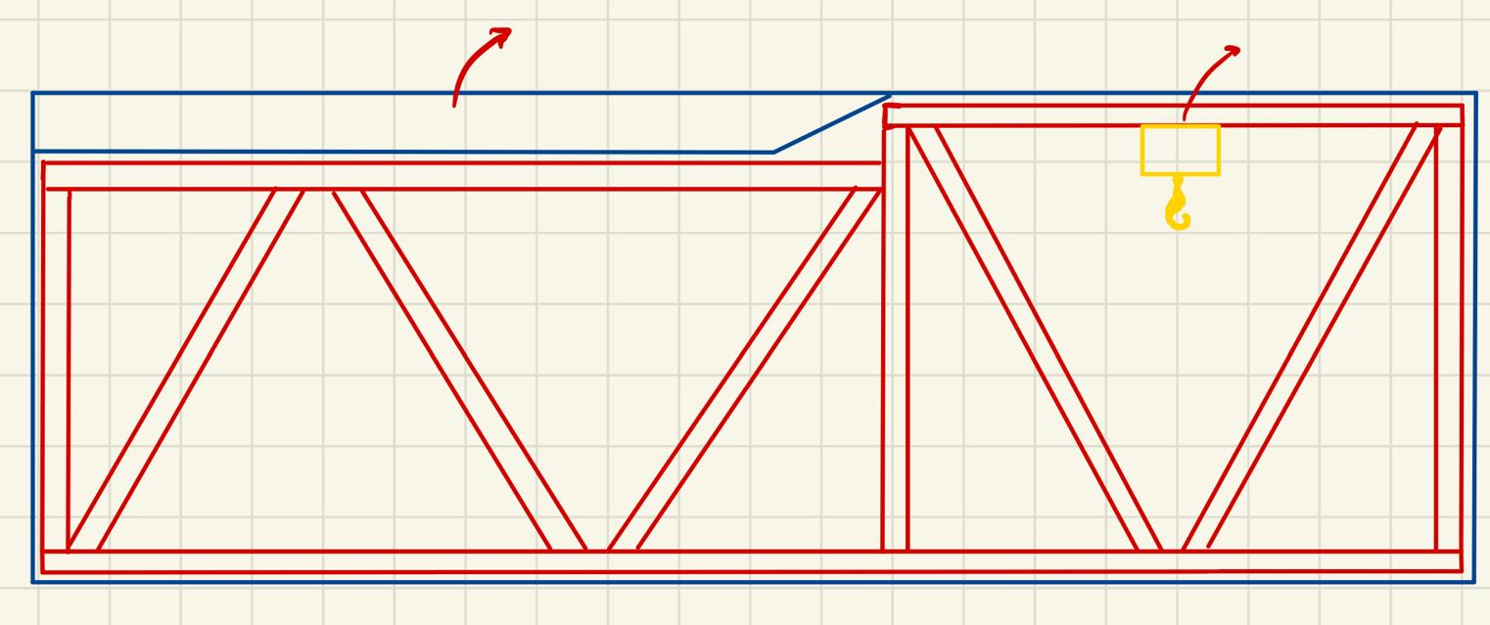
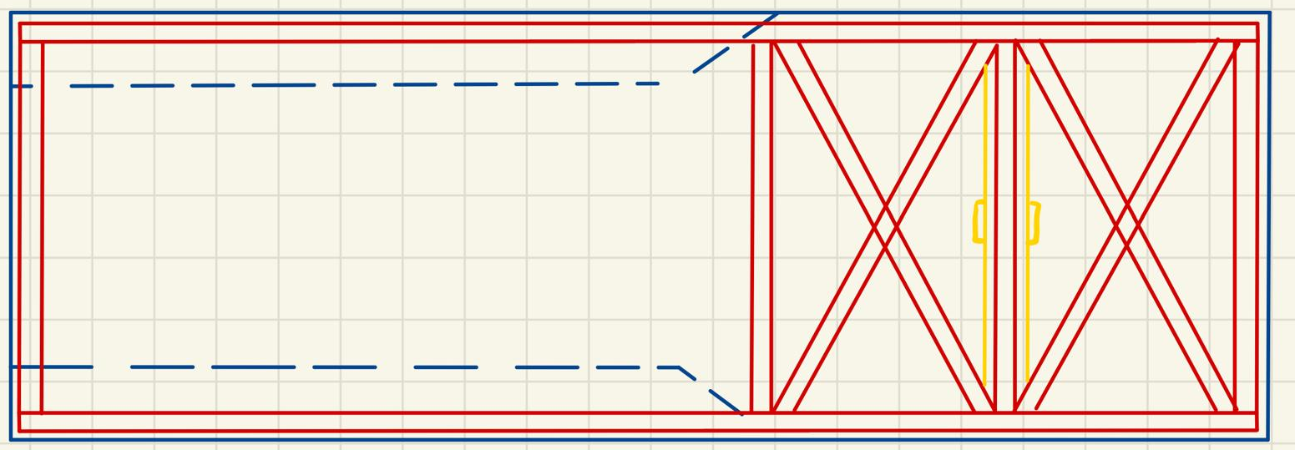
1. Nacelle cover design updates
Initial sketches for internal frame structure
Lid
Crane
View from above
View from the side
[1]
Federico De Mita

Slide 6
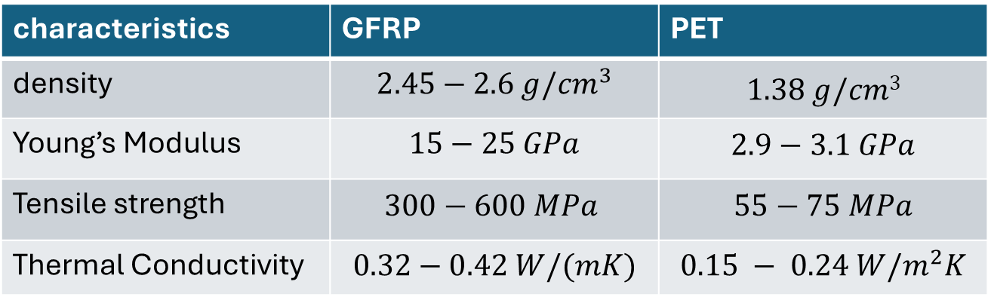
2. Nacelle cover material
New choice for material: sandwich with a GFRP skin and a core layer of PET foam
characteristics | GFRP | PET
density | $$2.45−2.6 g/{cm}^{3}$$ | $$1.38 g/cm3$$
Young’s Modulus | $$15−25 GPa$$ | $$2.9−3.1 GPa$$
Tensile strength | $$300−600 MPa$$ | $$55−75 MPa$$
Thermal Conductivity | $$0.32−0.42 W/(mK)$$ | $$0.15 − 0.24 W/m^{2}K$$
[3]
Federico De Mita

Slide 7
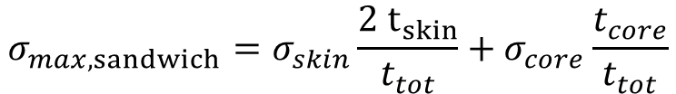
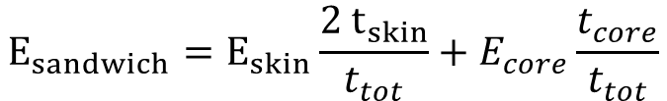
2. Nacelle cover material
To combine the characteristics of these 2 materials I will use, as a first approach, the rule of mixture, treating them as a unique isotropic composite material:
$$E_{sandwich}=E_{skin}\frac{2 t_{skin}}{t_{tot}}+E_{core}\frac{t_{core}}{t_{tot}}$$
skin
core
$$σ_{max, sandwich}=σ_{skin}\frac{2 t_{skin}}{t_{tot}}+σ_{core}\frac{t_{core}}{t_{tot}}$$
These formulas will be confirmed by next week and, once the design is finalized, the safety validation will be completed
[5]
Federico De Mita

Slide 8
2. Nacelle cover material
Reasons for material change:
Higher resistance to vibrations → lower noise propagation
More cost effective
Easier to manufacture: using a mold it is possible to create almost whichever shape
Lighter: using a sandwich panel reduces the quantity of composite material, compensating with a high strength core material of a lower density
Better response to buckling due to increased material strength
Different thermal behaviour: thermal insulator → the heat from outside will not be transported to the nacelle, especially the heat from the sun. The heat dissipation will be, therefore, total responsibility of the cooling system
[5]
Federico De Mita

Slide 9
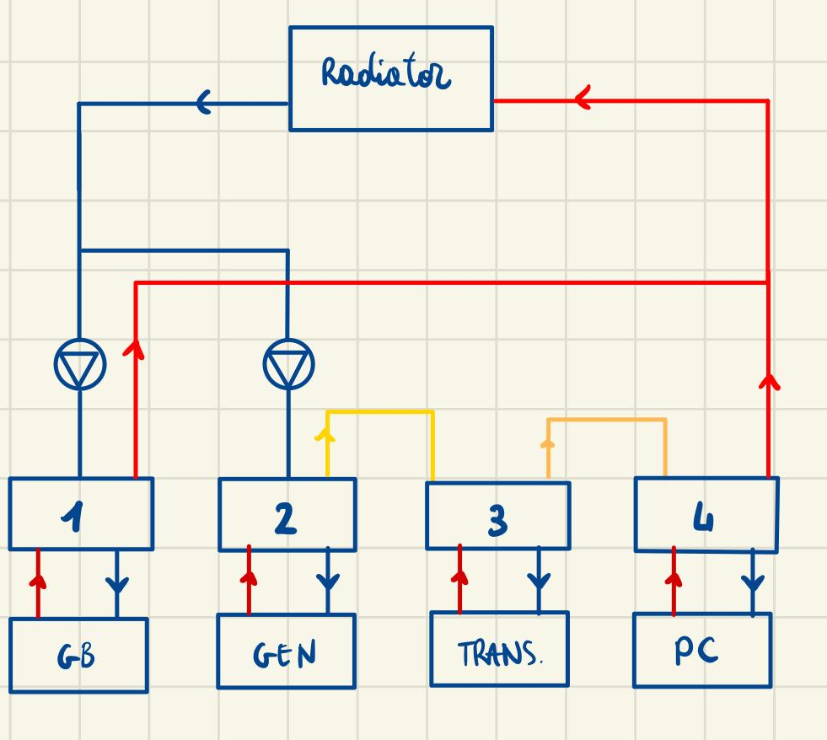
3. Cooling system arrangement
Mix between a semi-combined and a combined cooling system, with water (mixed with anti freeze liquids) as heat transporting fluid
This choice was made due to the low heat production in the transformer and the converter
the idea was to combine all the electrical components into a single line, and the gearbox into another
The two lines have a pump each that maintains the different flow rate for the two lines
Gearbox heat exchanger
Generator heat exchanger
Transformer heat exchanger
Converter heat exchanger
[6]
Federico De Mita

Slide 10
4. Next week
Next week:
Nacelle
  Design validation
  Dimension validation through other components updated dimensions
  Design optimization of the safety systems
  First load validation through DNV-GL guidelines
Cooling system
  System designing
  Contact with companies regarding a radiator
[5]
Federico De Mita

Slide 11
Bibliography – Managemente team SI
[1] self generated images and sketches
[2] “V236-15.0 MWTM.” Accessed: Nov. 17, 2025. [Online]. Available: https://www.vestas.com/en/energy-solutions/offshore-wind-turbines/V236-15MW
[3] Optimus Shakti Final Report, J. Stegert M. Elbanna
[4] “Polyethylene terephthalate - Wikipedia.” Accessed: Nov. 17, 2025. [Online]. Available: https://en.wikipedia.org/wiki/Polyethylene_terephthalate
[5] P. Mazzuca, “Flexural behaviour of GFRP sandwich panels with eco-friendly PET foam core for the rehabilitation of building floors,” Structures, vol. 60, Feb. 2024, doi: 10.1016/j.istruc.2023.105815.
[6] Optimus Oceanus Final Report, C. Röhling L. Peters
Federico De Mita

